Slide 1
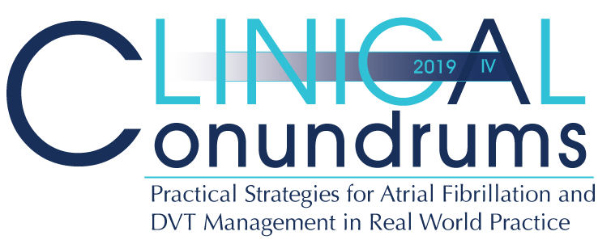


Case 7
CASE 5
Sue
Precision Medicine Applied to DOACs

Slide 2

Learning Objectives
Upon completion of this activity, participants should be able to:
I
Individualize anticoagulant therapy in AF patients who are elderly and/or have other co-morbidities
II
Manage DOACs in patients with different degrees of renal dysfunction and/or requiring various invasive procedures and surgical interventions

Slide 3

Case 7
Clinical Encounter 1
Notes:
Speaker Notes:

Slide 4
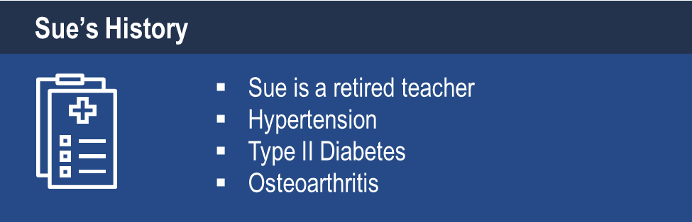
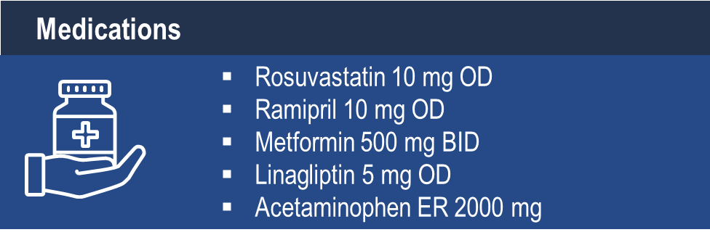
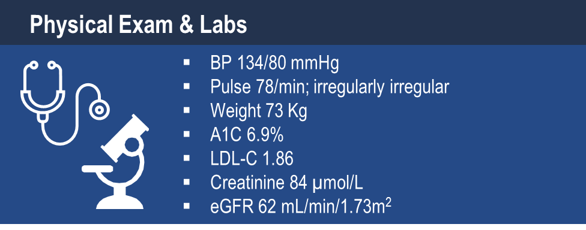
Case 7
Sue
74 years old
Notes:
Speaker Notes:
CrCl = 60 ml/min (corresponds closely to eGFR in this case)
Speaker could have participants calculate using the Thrombosis Canada -> Tools app
Speaker can also point out that calculating CrCl may be more clinically important for elderly patients of small stature (e.g. body weight < 60 kg) and when eGFR is between 30-40 ml/min/1.73m².

Slide 5

Case 7
Sue
74 years old
Sue comes in for a routine diabetes follow up visit.
She feels well but occasionally feels her “heart skipping”.
She doesn’t report associated dyspnea or chest pain.
BP 134/80, Pulse 78 BMP irregularly irregular
Notes:
Speaker Notes:
The ventricular response rate to this atrial fibrillation is auto-controlled. In the absence of therapy to accomplish this goal the finding of auto-controlled atrial fibrillation implies AV conduction system disease (usually AV nodal) and predicts the ultimate requirement for a pacemaker.

Slide 6
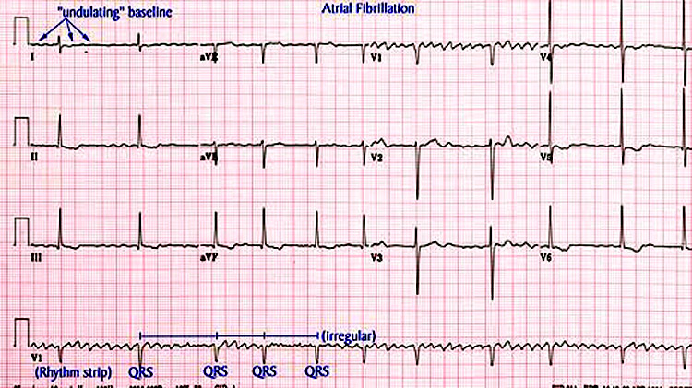
Case 7
Sue
74 years old
Sue’s ECG
Notes:
Speaker Notes:
The ventricular response rate to this atrial fibrillation is auto-controlled. In the absence of therapy to accomplish this goal the finding of auto-controlled atrial fibrillation implies AV conduction system disease (usually AV nodal) and predicts the ultimate requirement for a pacemaker.

Slide 7

What is your next management step with Sue?
Select from one of the available options
Send her to the ER
Refer her to local cardiologist electively and start ASA
Start a DOAC, order an echo
Tell Sue if it isn’t bothering her too much, not to worry
Notes:
Speaker Notes:
Correct Response 3: Start a DOAC, order an echo
In patients in whom AF is suspected based on symptoms or history of CVA or TIA, a longer term ECG monitoring such as Holter monitoring or event loop recording is recommended longer is better
Stress point that there is NO rush for her to see a cardiologist and in Ontario MOST like her would NOT

Slide 8
Case 7
You decide to start Sue on a DOAC.
Notes:
Speaker Notes:

Slide 9
Which DOAC would you select for Sue?
Select from one or more of the available options
Apixaban 5 mg BID
Apixaban 2.5 mg BID
Dabigatran 150 mg BID
Dabigatran 110 mg BID
Edoxaban 60 mg OD
Edoxaban 30 mg OD
Rivaroxaban 20 mg OD
Rivaroxaban 15 mg OD
Notes:
Speaker Notes:
Response Options: 1, 3, 5 & 7
Many options: can review pros and cons

Slide 10
DOACs as Compared to Warfarin Indirect Comparisons from the Clinical Trials
 | Apixaban¹ ^{(eliquis)} | Dabigatran 110² ^{(Pradaxa)} | Dabigatran 150² ^{(Pradaxa)} | EDOXABAN 60 ^{(lixiana)} | Rivaroxaban³ ^{(Xarelto)}
Stroke/SE
Major Bleed
Intracranial Bleed
GI Bleed
All Cause Death
To date there are no head-to-head trials between apixaban, dabigatran, edoxaban and rivaroxaban, therefore comparative efficacy and safety have not been established
Significant Increase
Significant Reduction
Non Significant Difference
Granger et al., NEJM 2011; 365: 981-992
Connolly et al., NEJM 2009; 361: 1139-1151
Patel et al., NEJM 2011; 365: 883-891
Giuliano RP et al NEJM 2013; 369:2091
Notes:
Speaker Notes:
This slide shows some key efficacy and safety outcome data vs. warfarin from the four major DOAC trials: RE-LY, ROCKET, ARISTOTLE and ENGAGE
Apixaban and Dabigatran 150 mg were associated with significant reduction of stroke/SE vs. warfarin.
Apixaban, Dabigatran 110 mg and Edoxaban were associated with significant reduction of major bleeding vs. warfarin.
All DOACs were associated with a significant reduction of intracranial bleeding (ICH) compared to warfarin.
Dabigatran 150 mg, Edoxaban and Rivaroxaban were associated with an increase in GI bleeding vs. warfarin.
Apixaban is associated with a significant reduction in mortality compared to warfarin.
Definition of major bleeding:
RE-LY: a reduction in the hemoglobin level of at least 20 g per liter, transfusion of at least 2 units of blood, or symptomatic bleeding in a critical area or organ.
ROCKET: as clinically overt bleeding associated with any of the following: fatal outcome, involving a critical site (i.e., intracranial, intraspinal, intraocular, pericardial, intraarticular, intramuscular with compartment syndrome, or retroperitoneal), or clinically overt bleeding associated with a fall in hemoglobin concentration of ≥ 2 g/dL, or leading to transfusion of ≥ 2 units of packed red blood cells or whole blood.
ARISTOTLE: clinically overt bleeding accompanied by a decrease in the hemoglobin level of at least 2 g per deciliter or transfusion of at least 2 units of packed red cells, occurring at a critical site, or resulting in death.
ENGAGE: International Society of Thrombosis and Hemostasis definition : clinically overt bleeding accompanied by a decrease in the hemoglobin level of at least 2 g per deciliter or transfusion of at least 2 units of packed red cells, occurring at a critical site, or resulting in death.
References:
﻿Connolly SJ, et al; for the RE-LY Steering Committee and Investigators. Dabigatran versus warfarin in patients with atrial fibrillation. N Engl J Med 2009; 361:1139-1151.
Connolly SJ, et al; for the RE-LY Investigators. Newly identified events in the RE-LY trial. N Engl J Med 2010; 363(19):1875-1876.
Patel MR, et al; and the ROCKET AF Steering Committee for the ROCKET AF Investigators. Rivaroxaban versus warfarin in nonvalvular atrial fibrillation. N Engl J Med 2011; 365:883-891.
Granger CB, et al; for the ARISTOTLE Committees and Investigators. Apixaban versus warfarin in patients with atrial fibrillation. N Engl J Med 2011; 365:981-992.

Slide 11
Case 7
Clinical Encounter 2
Notes:
Speaker Notes:

Slide 12
Case 7
Sue
74 years old
Sue has been diagnosed with AF
Your started her on apixaban 5 mg BID
Recently, the osteoarthritis in her knee has been flaring up and her acetaminophen is not helping her as much.
She wants to start Celecoxib to help her manage the pain
Notes:
Speaker Notes:

Slide 13
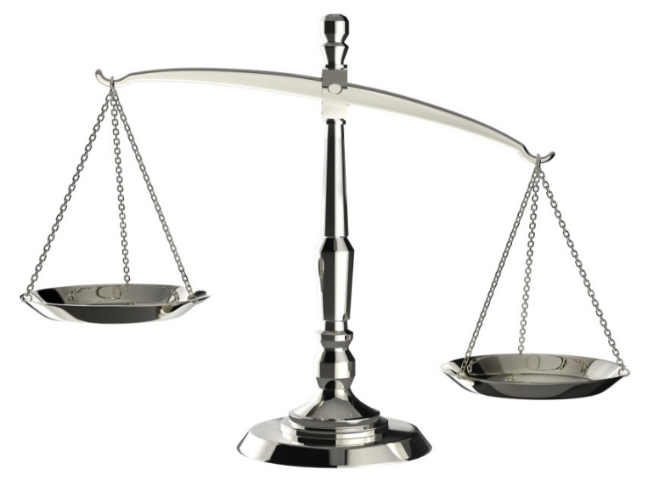
Balancing Stroke Prevention and Bleeding Risk
BLEEDING RISK
STROKE PREVENTION WITH DOAC
Older age
Female sex
Uncontrolled hypertension
Diabetes mellitus
Decreased renal function (CrCl <85 ml/min/1.73 m²)
Prior stroke
History of bleeding
Anemia (hematocrit <40%)
ASA or NSAIDs use
SSRI/SNRI
History of labile INR
The benefits of taking new oral anticoagulant (DOAC) therapy for stroke prevention outweigh the risk of bleeding in most cases, and the focus should be on reversing modifiable causes of bleeding.
Skanes et al. Can J Cardiol 2012;28(2):125-36.
Notes:
Key Points:
The purported GI bleeding risk with SSRIs and SNRIs is small and based on retrospective studies of heterogeneous populations with suboptimal control of co-existing bleeding risk factors. The CCS guidelines do not specifically address these agents. Caution needs to be exercised for AF patients who require a DOAC and are on these antidepressant agents. A PPI may also be a consideration particularly in someone who has already experienced previous upper GI bleeding.

Slide 14
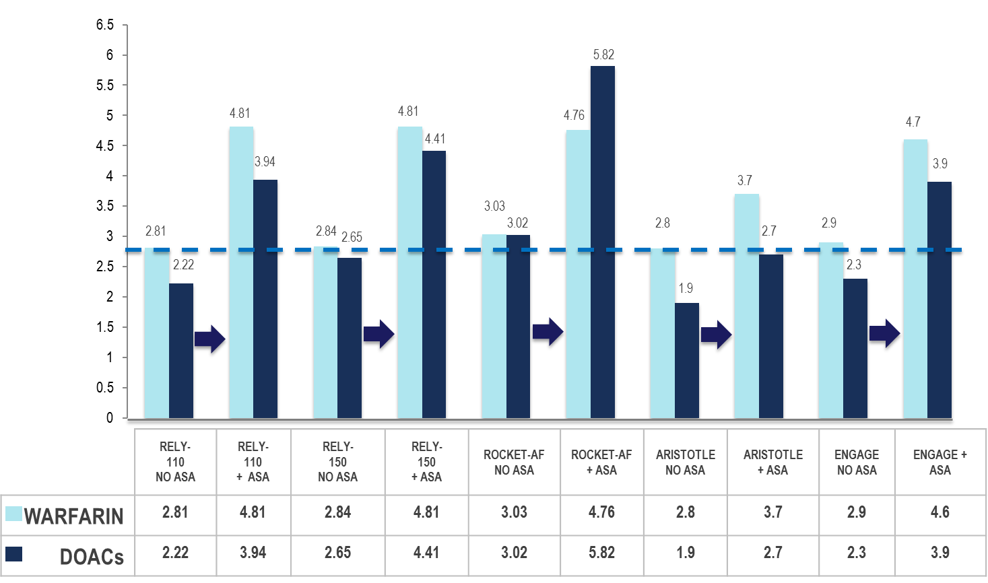
DOAC Indirect Comparisons Risk of Major Bleed / yr (%) w/wo ASA
Connolly SJ, et al. N Engl J Med. 2009; 361:1139−1151.
Patel MR, et al. N Engl J Med. 2011; 365:883−891.
Granger C, et al. N Eng J Med. 2011; 365:981−992.
Giuliano RP, et al. N Engl J Med. 2013;369:2093-2104.^{[6}
.
Notes:
Key Points:
1- consistent bleeding risk on warfarin never surpassed by any of the DOACs
2- dramatically higher major bleeding risk if ASA added and should avoid this at all costs
3- in RCTs, some DOACs / doses had less major bleeding than warfarin, whether or not ASA concurrently used

Slide 15
What do we offer Sue for her osteoarthritis flare up?
Select from one of the available options
Celecoxib as requested with PPI
OTC Naproxen (Aleve)
Acetaminophen with codeine
Acetaminophen
CBD Oil
PPI = Proton Pump Inhibitor
OTC = Over the Counter
Notes:
Speaker Notes:

Slide 16
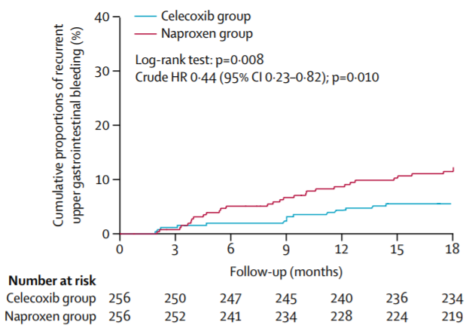
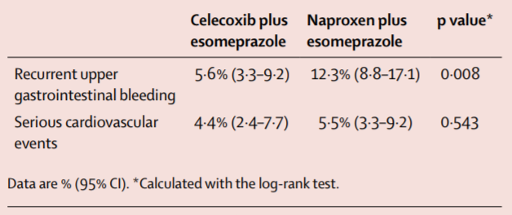
GI Safety of Celecoxib vs Naproxen in
Patients with Cardiothrombotic Diseases and Arthritis after Upper GI bleeding (CONCERN)
Time-to-outcome analysis of recurrent upper gastrointestinal bleeding
Kaplan-Meier estimates of the likelihood of recurrent upper gastrointestinal bleeding and serious cardiovascular events at 18 months
All patients received esomeprazole. 185 (72%) of 256 patients in the celecoxib group and 183 (71%) of 256 patients in the naproxen group continued aspirin. HR=hazard ratio.
Chan FKL, et al. Lancet 2017; 389: 2375–82
Notes:
Key Points:
Background
Present guidelines are conflicting for patients at high risk of both cardiovascular and gastrointestinal events who continue to require non-steroidal anti-inflammatory drugs (NSAIDs). We hypothesised that a cyclooxygenase-2-selective NSAID plus proton-pump inhibitor is superior to a non-selective NSAID plus proton-pump inhibitor for prevention of recurrent ulcer bleeding in concomitant users of aspirin with previous ulcer bleeding.
Methods
For this industry-independent, double-blind, double-dummy, randomised trial done in one academic hospital in Hong Kong, we screened patients with arthritis and cardiothrombotic diseases who were presenting with upper gastrointestinal bleeding, were on NSAIDs, and require concomitant aspirin. After ulcer healing, an independent staff member randomly assigned (1:1) patients who were negative for Helicobacter pylori with a computergenerated list of random numbers to receive oral administrations of either celecoxib 100 mg twice per day plus esomeprazole 20 mg once per day or naproxen 500 mg twice per day plus esomeprazole 20 mg once per day for 18 months. All patients resumed aspirin 80 mg once per day. Both patients and investigators were masked to their treatments. The primary endpoint was recurrent upper gastrointestinal bleeding within 18 months. The primary endpoint and secondary safety endpoints were analysed in the modified intention-to-treat population. This study was registered with ClinicalTrials.gov, number NCT00153660.
Findings
Between May 24, 2005, and Nov 28, 2012, we enrolled 514 patients, assigning 257 patients to each study group, all of whom were included in the intention-to-treat population. Recurrent upper gastrointestinal bleeding occurred in 14 patients in the celecoxib group (nine gastric ulcers and five duodenal ulcers) and 31 patients in the naproxen group (25 gastric ulcers, three duodenal ulcers, one gastric ulcer and duodenal ulcer, and two bleeding erosions). The cumulative incidence of recurrent bleeding in 18 months was 5·6% (95% CI 3·3–9·2) in the celecoxib group and 12·3% (8·8–17·1) in the naproxen group (p=0·008; crude hazard ratio 0·44, 95% CI 0·23–0·82; p=0·010). Excluding patients who reached study endpoints, 21 (8%) patients in the celecoxib group and 17 (7%) patients in the naproxen group had adverse events leading to discontinuation of treatment. No treatment-related deaths occurred during the study.
Interpretation
In patients at high risk of both cardiovascular and gastrointestinal events who require concomitant aspirin and NSAID, celecoxib plus proton-pump inhibitor is the preferred treatment to reduce the risk of recurrent upper gastrointestinal bleeding. Naproxen should be avoided despite its perceived cardiovascular safety.

Slide 17
Case 7
Clinical Encounter 3
Notes:
Speaker Notes:

Slide 18
Case 7
Sue
74 years old
Sue has been diagnosed with AF
Your started her on rivaroxaban 20 mg OD
Sue has come to see you with a form from her ophthalmologist that needs to be filled out for her upcoming cataract surgery
Notes:
Speaker Notes:

Slide 19
What would you advise Sue to do about to do about her Rivaroxaban prior to her cataract surgery?
Select from one of the following:
Stop rivaroxaban 2 days prior
Stop rivaroxaban 1 day prior
Don’t need to stop rivaroxaban
Switch to ASA
Notes:
Speaker Notes:
Correct Answer: 3 (Don’t need to stop rivaroxaban)

Slide 20
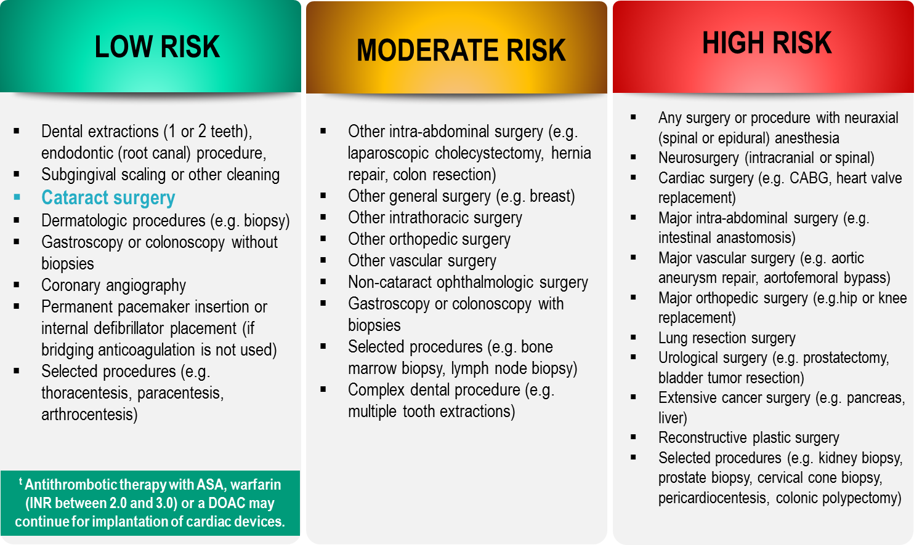
Bleeding Risks for Invasive /
Surgical Procedures
CCS AF Guidelines. Can J Cardiol. 2016; 32: 1170-1185
Thrombosis Canada Clinical Guide. Warfarin: Peri-Operative Management. www.thrombosiscanada.ca
BRUISE-CONTROL 2 – Presented at the AHA Scientific Sessions, Anaheim CA - Nov 2017
Notes:
Speaker Notes:
Steering committee recommendation; In addition to the bleeding risk of a procedure, physicians should consider co-morbid conditions that might exacerbate the bleeding risk (e.g. advanced age, renal or liver impairment).
Many invasive and surgical procedures carry but a very low to low risk of bleeding – DOACs may be held only briefly or even continued without interruption during such procedures as will be discussed in case #2
Antithrombotic therapy with warfarin but not a DOAC can be safely continued pre-post pacemaker or ICD insertion
DOACs never need to be bridged with subcutaneous heparin peri-invasive or surgical procedures due to their short duration of action
REFERENCES:
Douketis JD, Spyropoulos AC, Spencer FA, et al. Perioperative management of antithrombotic therapy: Antithrombotic Therapy and Prevention of Thrombosis, 9th ed: American College of Chest Physicians Evidence-Based Clinical Practice Guidelines. Chest. 2012;141(2 Suppl):e326S - 50S.
Verma A, Cairns JA, Mitchell LB, et al. 2014 focused update of the Canadian Cardiovascular Society
Guidelines for the management of atrial fibrillation. Can J Cardiol. 2014;30(10):1114-1130.
Horlocker TT, Wedel DJ, Rowlingson JC, et al. Regional anesthesia in the patient receiving antithrombotic or thrombolytic therapy: American Society of Regional Anesthesia and Pain Medicine Evidence-Based Guidelines (Third Edition). Reg Anesth Pain Med. 2010;35(1):64-101.
XARELTO-PM-ENG-10JUL2014-172618.pdf. http://www.bayer.ca/files/XARELTO-PM-ENG-10JUL2014-
172618.pdf? Accessed 11 Nov 2014
Pfizer Canada Inc Eliquis Product Monograph. http://www.pfizer.ca/en/our_products/products/monograph/313. Accessed 11 Nov 2014
Boehringer Ingelheim Canada Ltd. (2014) Pradaxa Product Monograph. http://www.boehringer- ingelheim.ca/content/dam/internet/opu/ca_EN/documents/humanhealth/product_monograph/Prad axaPMEN.pdf. Accessed 11 Nov 2014
Thrombosis Canada. http://thrombosiscanada.ca/

Slide 21

CCS 2016 Clinical
Practice Recommendations
RECOMMENDATION
We suggest that interruption of anticoagulant therapy, particularly for VKAs, in a patient with AF/AFL is not necessary for most procedures with a low risk of bleeding, such as cardiac device implantation (pacemaker or implantable defibrillator), and most dental procedures
AF = Atrial Fibrillation
AFL = Atrial Flutter
(Conditional Recommendation, Moderate-Quality Evidence)
2016 Focused Update of the Canadian Cardiovascular Society Guidelines for the Management of Atrial Fibrillation
Macle, Laurent et al. Canadian Journal of Cardiology , Volume 32 , Issue 10 , 1170 - 1185
Notes:
Speaker Notes:

Slide 22
Case 7
Clinical Encounter 4
Notes:
Speaker Notes:

Slide 23
Case 7
Sue
80 years old
Sue is now 80 years old and has been on Dabigatran 150 mg BID thus far
Her eGFR is now down to 42 ml/min/1.73 m² (creatinine 104 μmmol/L)
You are concerned and wonder what to do about her DOAC.
Notes:
Speaker Notes:
- Assuming her weight is unchanged at 73 Kg, her CrCl is now 44 ml/min and dosage reductions of dabi, riva and edo are in order. Since her weight is above 60Kg and her creatinine is < 133μmmol/L, she can take full dose apixaban 5 mg bid.
- Although both doses of dabigatran 110 mg bid and 150 mg bid were tested in the RELY study without apparent interaction in terms of safety and efficacy with reduced renal function, most clinicians would switch Sue to either the dabi 110 mg bid dosage (c/w CCS Guidelines) or to another DOAC because of safety (i.e. bleeding) concerns.

Slide 24
What do you do about Sue’s DOAC?
Select from one or more of the available options
Continue with dabigatran 150 mg BID
Switch to dabigatran 110 mg BID
Switch to rivaroxaban 20 mg OD
Switch to rivaroxaban 15 mg OD
Switch to apixaban 5mg BID
Switch to apixaban 2.5 mg BID
Switch to edoxaban 60 mg OD
Switch to edoxaban 30 mg OD
Notes:
Speaker Notes:
Response Options: 2, 4, 5 & 8

Slide 25
Stroke Prevention in AF: Clinical Pharmacology and Dosing of DOACs
 | Apixaban ^{(eliquis)} | Dabigatran ^{(Pradaxa)} | EDOXABAN ^{(lixiana)} | Rivaroxaban ^{(Xarelto)}
Mechanism of action | Direct Factor Xa inhibitor | Direct thrombin inhibitor | Direct Factor Xa inhibitor | Direct Factor Xa inhibitor
Oral bioavailability | ~50% | ~6.5% | 62% | 80-100%
Pro-drug | No | Yes | No | No
Food effect | No | No | No | Yes (needs to be taken with food)
Renal clearance | ~27% | 85% | 50% | 36% *
Mean half-life (t_{1/2}) | ~12 h | 11-17h | 10-14h | 5-13 h
T_{max} | 3-4 h | 0.5-2 h | 1-2h | 2-4 h
Recommended daily dose | 5 mg BID | 150 mg BID | 60 mg QD | 20 mg QD
Pfizer Canada Inc./BMS Canada. Eliquis (apixaban) Product Monograph, June 16, 2016.
Boehringer Ingelheim Canada Ltd. Pradaxa (dagbatran) Product Monograph. August 11, 2016.
Bayer Inc. Xarelto (rivaroxaban) Product Monograph. July 20, 2015.
Daiichi Sankyp Inc. Lixiana (edoxaban) Product Monograph. November 2, 2016.
* Rivaroxaban is 66% renally cleared and its active metabolite is 36% renally cleared
Notes:
Speaker Notes:
DOACs can be differentiated based on efficacy and bleeding risk in the clinical trials ( and real-world experience available and forthcoming…) with the limitations of indirect clinical comparisons duly acknowledged. DOACs can also be differentiated based on other factors as summarized in this slide. Parameters such as borderline renal function, sensitivity to dyspepsia, irregular food intake, need for blister pack medication preparation by pharmacist, cognitive dysfunction and medication non compliance to BID dosing etc etc can determine selection of the best agent for a given patient!
The Tmax of all DOACs is a short 2-4 hours. This means that, unlike with warfarin, a patient is rapidly anticoagulated within just two hours following a DOAC dose. This has important implications for heparin “bridging” which is no longer required with DOACs as well as for the timing of resumption of DOAC therapy following procedures.
All DOACs share a short 12 hour half-life in the setting of preserved renal function (CrCl > 60 ml/min). This is a major advantage over warfarin which has a half-life of 36 hours or longer depending on hepatic function. Most procedures at intermediate or high bleeding risk can be performed within 1-2 days respectively of withholding a DOAC with additional delay required with renal dysfunction. Moreover, major bleeding can usually be controlled with local and supportive measures as the effect of the DOAC wears off quickly. Specific DOAC antidotes are therefore rarely required.

Slide 26
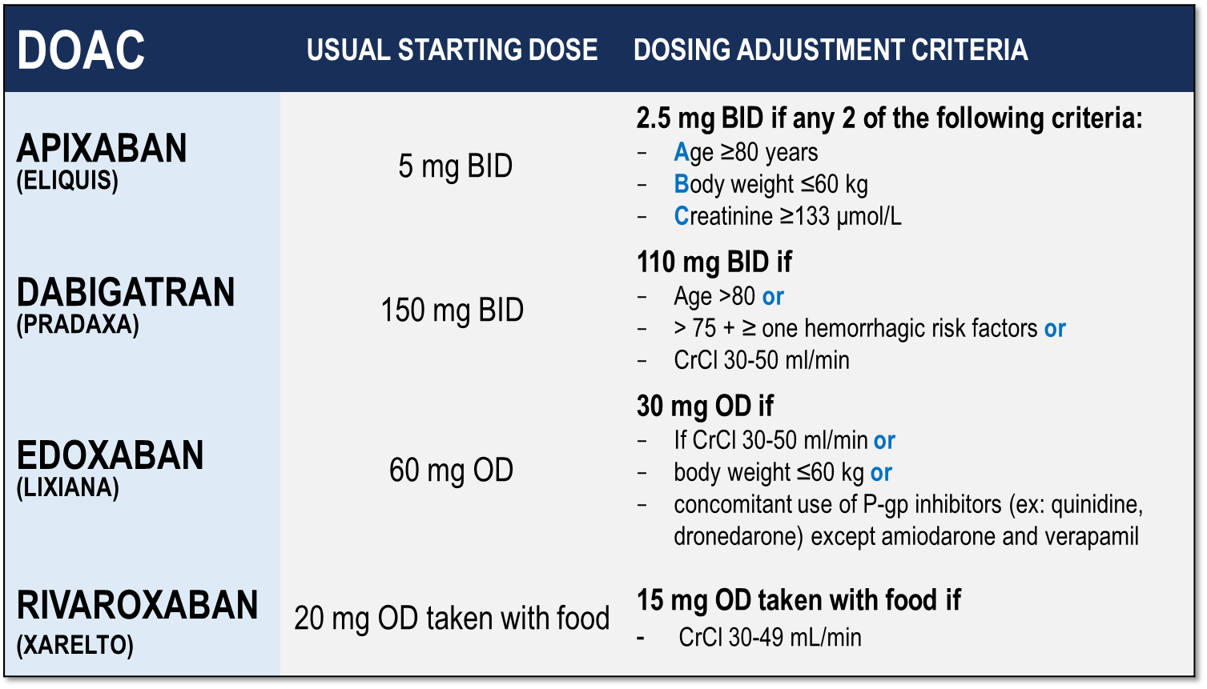
Considerations for Dosing of DOACs
Pfizer Canada Inc./BMS Canada. Eliquis (apixaban) Product Monograph, 2018.
Boehringer Ingelheim Canada Ltd. Pradaxa (dagbatran) Product Monograph. August 11, 2016.
Bayer Inc. Xarelto (rivaroxaban) Product Monograph. 2018.
Daiichi Sankyp Inc. Lixiana (edoxaban) Product Monograph. 2017.
Notes:
Speaker Notes:
Indispensable slide summarizing the criteria for a dosage adjustment from the default higher dosage for the different DOACs currently available in Canada
The dosing adjustments proposed for apixaban, edoxaban and rivaroxaban are those utilized to the dosage of selected patients enrolled in the respective prospective clinical trials (ARISTOTLE, ENGAGE and ROCKET-AF). The overall goal was to achieve a stable plasma concentration in subjects assigned to DOAC therapy in these studies.
The speaker should emphasize that the RELY study, in fact, tested two separate dosages of dabigatran (150 mg and 110 mg BID) independently against warfarin, without a pre-specified dosage reduction algorithm for reduced renal function. Since dabigatran is known to be 85% renally cleared, the Canadian AF Guidelines Committee subsequently proposed dosing adjustments (as did all other guideline committees), as listed in the table, for elderly patients and those with stage 3 renal dysfunction in order to minimize the risk of drug accumulation and bleeding in these patients.

Slide 27
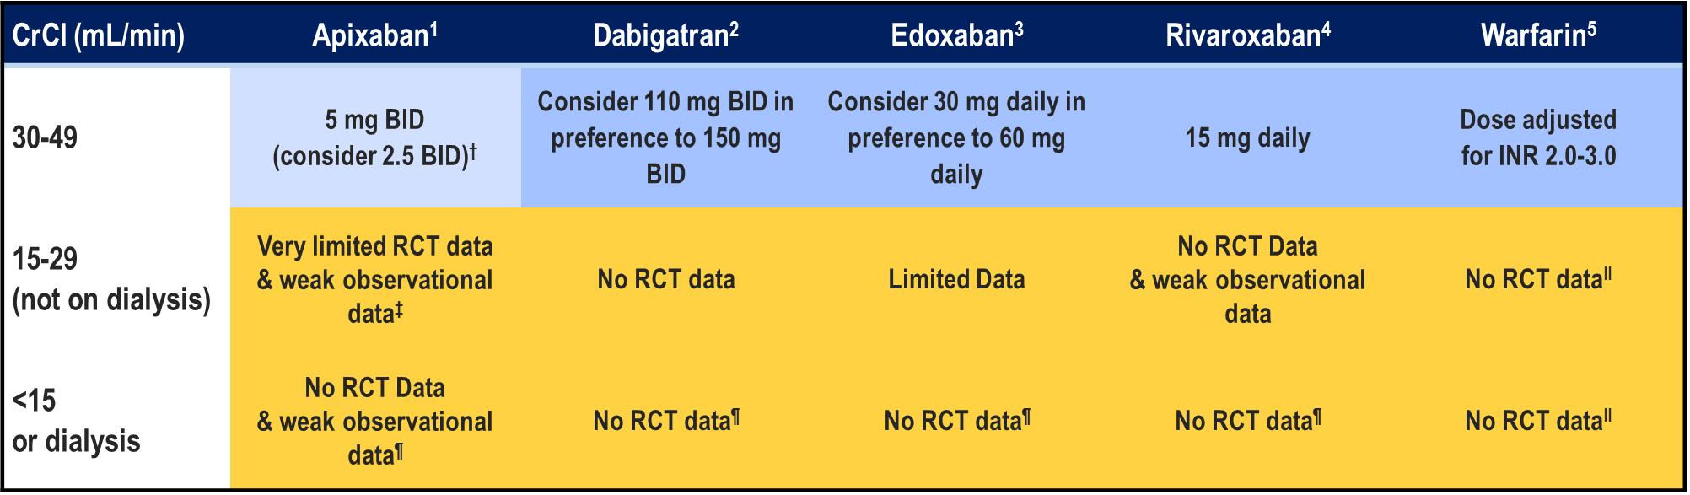
Prevention of Stroke in Patients with CKD Therapeutic Choices
Pfizer Canada Inc./BMS Canada. Eliquis (apixaban) Product Monograph, 2018.
Boehringer Ingelheim Canada Ltd. Pradaxa (dagbatran) Product Monograph. August 11, 2016.
Bayer Inc. Xarelto (rivaroxaban) Product Monograph. 2018.
Daiichi Sankyp Inc. Lixiana (edoxaban) Product Monograph. 2017.
Notes:
Speaker Notes:
The DOACs are at least partially eliminated by the kidneys. Dabigatran and edoxaban have the greatest dependence on renal elimination (~85% and 50%, respectively),^{8, 9} whereas 27% and 33% of apixaban and rivaroxaban, respectively, are renally cleared as unchanged drug.

Slide 28
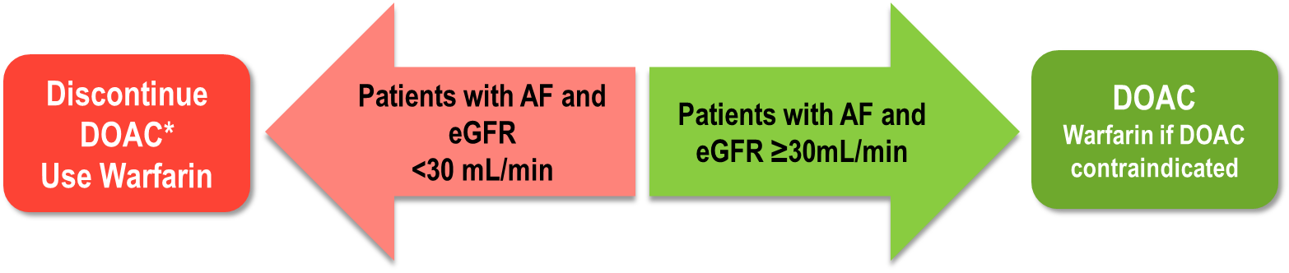
CCS Guidelines Recommend DOACs for Eligible AF Patients with eGFR ≥30 mL/min
Some expert opinions¹ prefer apixaban if eGFR 30-50 ml/min/1.73m²
CrCl <15mL/min (on dialysis):
We suggest that such patients not routinely receive either OAC or ASA for stroke prevention in AF (Conditional Recommendation, Low Quality Evidence).
*D/C apixaban if eGFR < 25 ml/min/1.73 m²
CCS: Canadian Cardiovascular Society; eGFR: estimated glomerular filtration rate.
1. Cairns JA. Can J Cardiol 2013;29:1165
2. Skanes AC et al. Can J Cardiol 2012;28:125 3. Verma A et al. Can J Cardiol 2014;30:1114-1130
Michels et al. Clin J Am Soc Nephrol 2010;(5):1003–1009. doi: 10.2215/CJN.06870909
**Pfizer Canada Inc./BMS Canada. Eliquis (apixaban) Product Monograph, June 16, 2016
Notes:
Speaker Notes:

Slide 29
Reviewing the Data: Apixaban
Outcomes in ARISTOTLE According to Renal Function
 | Apixaban | Warfarin | Hazard Ratio (95% CI) | P value Interaction
 | Number of events (%/yr)
Stroke / SE |  |  |  | : 0.705
eCrCl >80 mL/min* | 0.99% (70) | 1.12% (79)
eCrCl >50-80 mL/min† | 1.24% (87) | 1.69% (116)
eCrCl ≤50 mL/min‡ | 2.11% (54) | 2.67% (69)
Major bleeding |  |  |  | : 0.03
eCrCl >80 mL/min* | 1.46% (96) | 1.84% (119)
eCrCl >50-80 mL/min† | 2.45% (157) | 3.21% (199)
eCrCl ≤50 mL/min‡ | 3.21% (73) | 6.44% (142)
N=7,518
0.25
0.5
1.00
1.5
2.0
Apixaban better
Warfarin better
*n=7518 (41%); †n=7587 (42%); ‡n=3017 (17%) Results were consistent regardless of methods for GFR estimation Hohnloser SH et al. Eur Heart J 2012; 22:2821-30.
Notes:
Speaker Notes:
Stroke / SE efficacy advantage of apixaban over warfarin in the Aristotle population was unaffected by renal dysfunction with non significant p value for interaction.
Major bleeding increased (tripled) in both apixaban and warfarin arms the study highlighting the important effect of renal dysfunction on bleeding risk
Apixaban appeared particularly safe vs. warfarin in the subgroup with CrCl < 50 ml/min with a 50% reduction in risk of major bleeding (P value for interaction significant at 0.03)

Slide 30
Reviewing the Data: Dabigatran
Outcomes of Dabigatran 110 mg BID & 150 mg BID in RE-LY According to Renal Function
 | Hazard Ratio (95% CI) Dabi 110 vs. Warfarin | P value Interaction | Hazard Ratio (95% CI) Dabi 150 vs. Warfarin | P value Interaction
Stroke / SE |  | : 0.911 |  | : 0.752
eCrCl ≥80 mL/min*
eCrCl 50-<80 mL/min†
eCrCl <50 mL/min‡
Major bleeding |  | : 0.061 |  | : 0.639
eCrCl ≥80 mL/min*
eCrCl 50-<80 mL/min†
eCrCl <50 mL/min‡
0.25
0.5
1.00
1.5
2.0
0.25
0.5
1.00
1.5
2.0
Dabi 110 better
Warfarin better
Dabi 150 better
Warfarin better
N= 18,113
*n=5844 (32.6%); † n=8553 (47.6%); ‡ n=3554 (19.8%)
Results were consistent regardless of methods for GFR estimation Hijazi Z et al. Circulation 2014; 129:961-70.
Notes:
Speaker Notes:
Both dosages of dabigatran were tested against warfarin in RELY regardless of renal function down a CrCl of 30 ml/min
There was no interaction for efficacy OR major bleeding safety with either dosage tested and tertiles of renal function as shown in the slide.

Slide 31
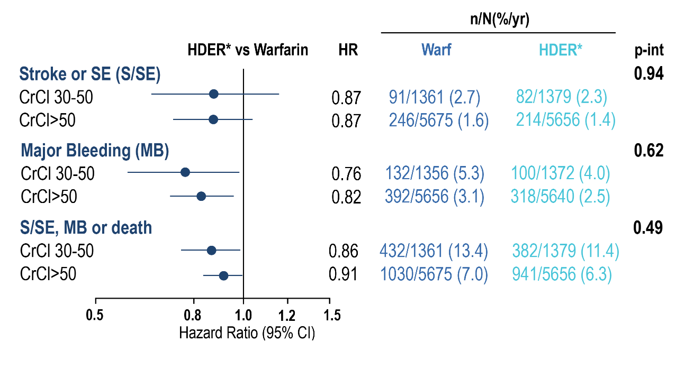
Reviewing the Data: Edoxaban
Outcomes in the ENGAGE AF-TIMI 48 Trial According to Renal Function
Warfarin HDER*
91/1361 (2.7)
246/5675 (1.6)
82/1379 (2.3)
214/5656 (1.4)
132/1356 (5.3)
392/5656 (3.1)
100/1372 (4.0)
318/5640 (2.5)
432/1361 (13.4)
1030/5675 (7.0)
382/1379 (11.4)
941/5656 (6.3)
Favours HDER*
Favours Warfarin
*HDER of 60 mg daily or 30 mg daily if dose reduced for creatinine clearance (CrCl) ≤50 mL/min, weight ≤60 kg, or potent phosphorylated glycoprotein inhibitor use.
Impact of Renal Function on Outcomes With Edoxaban in the ENGAGE AF-TIMI 48 Trial, Volume: 134, Issue: 1, Pages: 24-36, DOI: (10.1161/CIRCULATIONAHA.116.022361)
Notes:
Speaker Notes:
Data for the efficacy and net clinical outcome analyses are from the intention-to-treat population for the overall study period. Data for safety are from the safety cohort for the treatment period with interval censoring of events during study-drug interruptions that lasted >3 days. CrCl (mL/min) at randomization was estimated with the Cockcroft-Gault equation. CI indicates confidence interval; HDER, higher-dose edoxaban regimen; HR, hazard ratio; P-int, P for interaction for treatment by renal subgroup; and S/SE, stroke or systemic embolism. *HDER of 60 mg daily or 30 mg daily if dose reduced for creatinine clearance (CrCl) ≤50 mL/min, weight ≤60 kg, or potent phosphorylated glycoprotein inhibitor use.

Slide 32
Reviewing the Data: Rivoraxaban
Outcomes in ROCKET-AF According to Renal Function
 | Rivaroxaban | Warfarin | Hazard Ratio (95% CI) | P value Interaction
 | Number of events per 100 pt-yrs
Stroke / SE |  |  |  | : 0.76
eCrCl ≥50 mL/min* | 1.57 | 2.00
eCrCl 30-49 mL/min† | 2.32 | 2.77
Major bleeding |  |  |  | : 0.48
eCrCl ≥50 mL/min* | 3.39 | 3.17
eCrCl 30-49 mL/min† | 4.49 | 4.70
0.25
0.5
1.00
1.5
2.0
N= 14,264
Rivaroxaban better
Warfarin better
*rivaroxaban 20 mg (n=5637; 79%); †rivaroxaban 15 mg (n=1474; 21%); per protocol population Fox KAA et al. Eur Heart J 2011; 32:2387-94
Notes:
Speaker Notes:
- There was no interaction for stroke/SE efficacy OR major bleeding safety with rivaroxaban vs. warfarin with reduced renal function, dosage adjusted to 15 mg daily at CrCl < 50 ml/min.

Slide 33
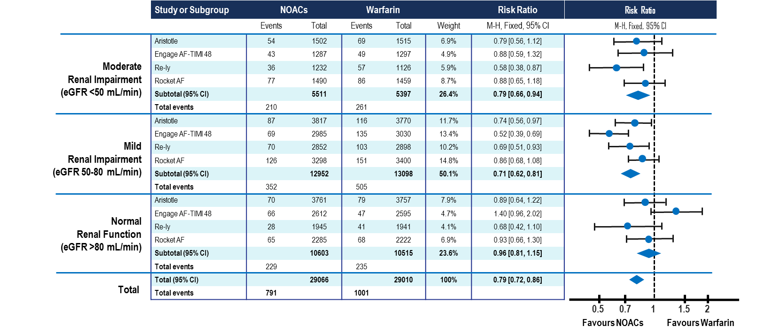
Efficacy of DOACs vs. Warfarin for Stroke / Systemic Embolism by Renal Function
(Meta-Analysis of Major DOAC Trials)
Del-Carpio Munoz F, et al. Am J Cardiol 2016; 117:69-75.
Notes:
Speaker Notes:

Slide 34
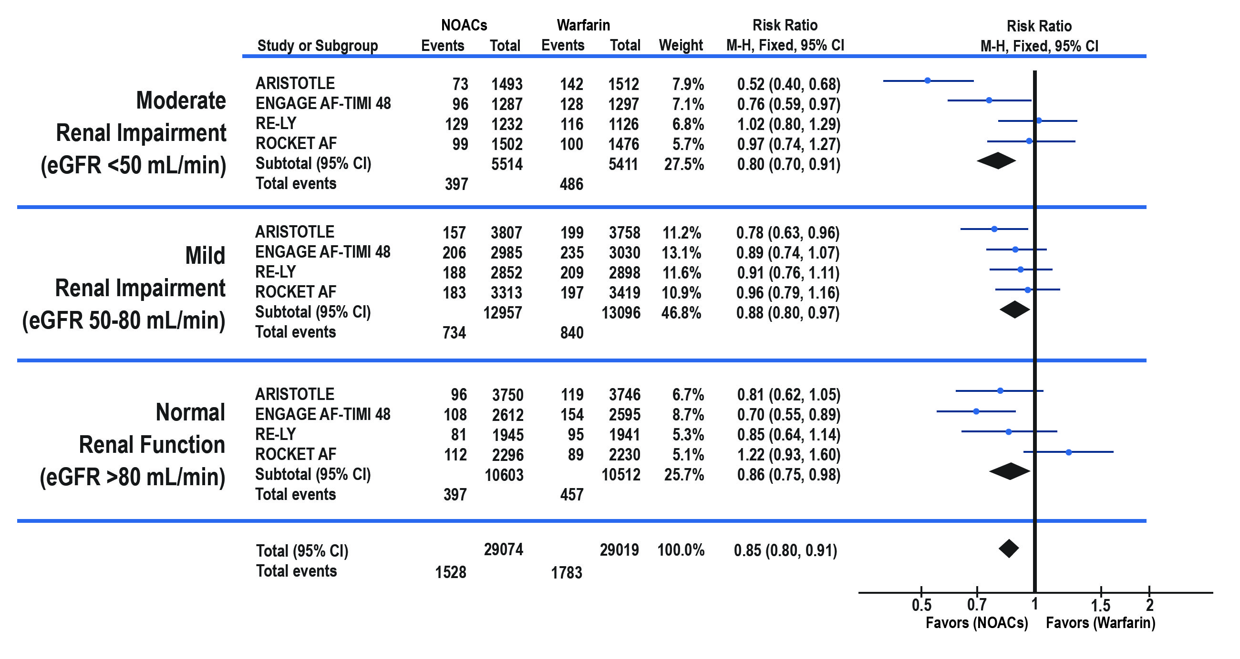
DOACs Have Lower Risk of Major Bleeding vs. Warfarin Across Strata of Renal Function
(Meta-Analysis of Major DOAC Trials)
Favors (DOAC)
Favors (Warfarin)
Del-Carpio Munoz F, et al. Am J Cardiol 2016; 117:69-75.
Notes:
Speaker Notes:

Slide 35
Case 7
Clinical Encounter 5
Notes:
Speaker Notes:

Slide 36
Case 7
Sue
75 years old
Sue is 75 years old and has been on Edoxaban 60 mb OD
She recently fell and fractured her hip
You are the ER physician and have referred her to ortho who wishes to operate ASAP but they tell you to sort out her anticoagulation first.
Notes:
Speaker Notes:
Key point for PCPs and most ER docs would be that local management and time are effective measures to control MOST cases of bleeding on DOACs; Adarucisumab is for excpetional cases (ICH, major polytrauma), used only for dabi, and carry cost as well as risk of ischemic event (5% at one month) from rapid anticoag reversal! The vast majority of "urgent surgery" can be postponed 1-2 days to allow the DOAC effect to wear off (short half life of 12 hrs). Idaru rarely needed for "urgent surgery"!

Slide 37
What do you tell Sue with respect to her edoxaban?
Select from one of the following:
Don’t need to stop edoxaban
Give last dose 2 days before surgery (e.g. skip 1 dose)
Give last dose 3 days before surgery (e.g. skip 2 doses)
Give last dose 5 days before surgery (e.g. skip 4 doses)
Notes:
Speaker Notes:
Correct Answer 3: Give last dose 3 days before surgery (e.g. skip 2 doses)

Slide 38
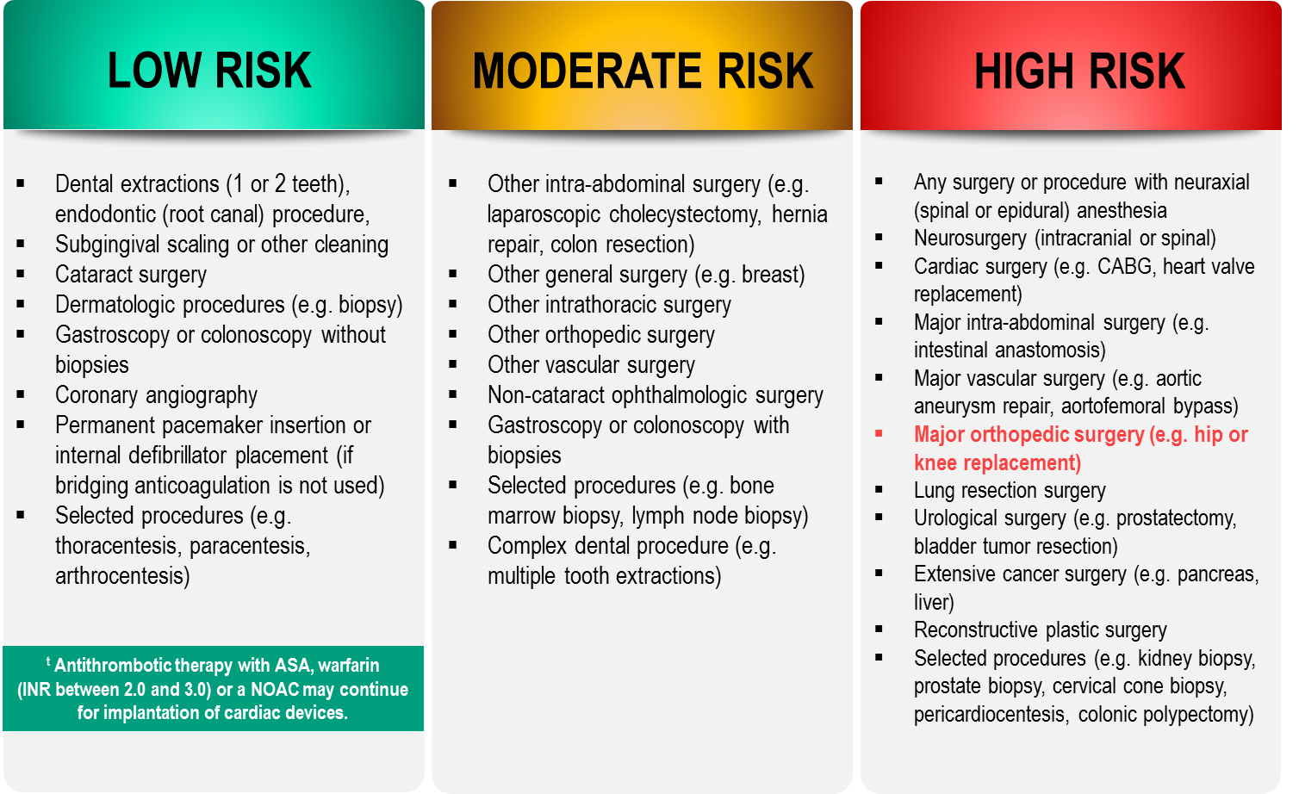
Bleeding Risks for Invasive /
Surgical Procedures
CCS AF Guidelines. Can J Cardiol. 2016; 32: 1170-1185
Thrombosis Canada Clinical Guide. Warfarin: Peri-Operative Management. www.thrombosiscanada.ca
BRUISE-CONTROL 2 – Presented at the AHA Scientific Sessions, Anaheim CA - Nov 2017
Notes:
Speaker Notes:
Steering committee recommendation; In addition to the bleeding risk of a procedure, physicians should consider co-morbid conditions that might exacerbate the bleeding risk (e.g. advanced age, renal or liver impairment).
Many invasive and surgical procedures carry but a very low to low risk of bleeding – NOACs may be held only briefly or even continued without interruption during such procedures as will be discussed in case #2
Antithrombotic therapy with warfarin but not a NOAC can be safely continued pre-post pacemaker or ICD insertion – recent BRUISE CONTROL II Study shows no difference between warfarin and NOAC
NOACs never need to be bridged with subcutaneous heparin peri-invasive or surgical procedures due to their short duration of action
REFERENCES:
Douketis JD, Spyropoulos AC, Spencer FA, et al. Perioperative management of antithrombotic therapy: Antithrombotic Therapy and Prevention of Thrombosis, 9th ed: American College of Chest Physicians Evidence-Based Clinical Practice Guidelines. Chest. 2012;141(2 Suppl):e326S - 50S.
Verma A, Cairns JA, Mitchell LB, et al. 2014 focused update of the Canadian Cardiovascular Society
Guidelines for the management of atrial fibrillation. Can J Cardiol. 2014;30(10):1114-1130.
Horlocker TT, Wedel DJ, Rowlingson JC, et al. Regional anesthesia in the patient receiving antithrombotic or thrombolytic therapy: American Society of Regional Anesthesia and Pain Medicine Evidence-Based Guidelines (Third Edition). Reg Anesth Pain Med. 2010;35(1):64-101

Slide 39
CCS 2016 Clinical
Practice Recommendations
RECOMMENDATION
We recommend that the interruption of anticoagulant therapy in a patient with AF/AFL will be necessary for most procedures with an intermediate or high risk of major bleeding
(Strong Recommendation, Low-Quality Evidence)
AF = Atrial Fibrillation
AFL = Atrial Flutter
2016 Focused Update of the Canadian Cardiovascular Society Guidelines for the Management of Atrial Fibrillation
Macle, Laurent et al. Canadian Journal of Cardiology , Volume 32 , Issue 10 , 1170 - 1185
Notes:
Speaker Notes:

Slide 40
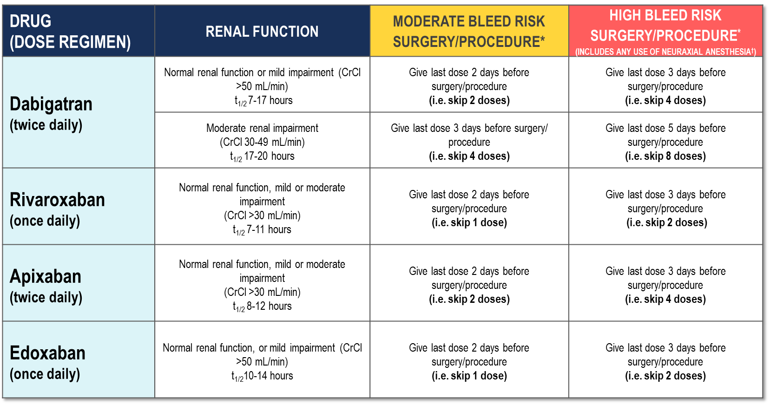
Peri-Operative Guide
*No anticoagulant taken on the day of surgery/procedure.
†Neuraxial procedures include spinal anesthesia, epidural catheter insertion and epidural catheter removal.
2017 Thrombosis Canada
Notes:
Speaker Notes:
Patients with Impaired Renal Function: For patients with severe renal dysfunction (CrCl <30 mL/min) who are generally ineligible for DOACs, peri-operative management is unclear.

Slide 41
DOAC Antidotes
Andexanetª ^{(PRT064445)} | Antidote for factor Xa inhibitors Recombinant protein binding to factor Xa inhibitor site
Aripazine^{b} ^{(PER977)} | Antidote for factor Xa inhibitors, direct thrombin inhibitors, low molecular-weight heparins, and fondaparinux Synthetic small molecule; reversal effect through direct binding to anticoagulant
Idarucizumab^{c} ^{(BI 655075)} | Antidote for direct thrombin inhibitors Fully humanized antibody fragment
a. Clinicaltrials,gov; NCT01758432 16; b Dolgin E. Nat Med. 2013;19:251(17), c, Clinicaltrials.gov;NCT01955720.{18}
Notes:
Speaker Notes:
Idarucizumab (Praxbind™) is approved in the US as well as Canada and is available for rapid dabigatran effect reversal in highly selected situations. These include emergent need for surgery (major trauma), need for thrombolysis for ischemic stroke, and suspected dabigatran overdose)
Andexanet Alpha (AndexXa™) was approved by the FDA in the US in May 2018 but is still awaiting approval by Health Canada at the present time. It is “decoy” Xa recombinant protein that binds to any of the anti-Xa DOACs (apixaban, rivaroxaban, edoxaban) thus sequestering them and interrupting their anticoagulant activity. As with Idarucizumab, a high selective usage is anticipated once approved in this country.
It is important to keep in mind that all DOAC antidotes have the potential of pro-thrombotic complications (eg. MI, ischemic stroke) that can reach a rate of 5% at one month. The benefit-risk of their use should therefore carefully be individualized.

Slide 42
When would you tell Sue to resume her DOAC post surgery?
Select from one or more of the following options:
Immediately after the procedure
The next day
In 2-3 days
When the orthopedic surgeon recommends
Notes:
Speaker Notes:
Correct Answer 3: In 2-3 days & 4: When the orthopedic surgeon recommends

Slide 43
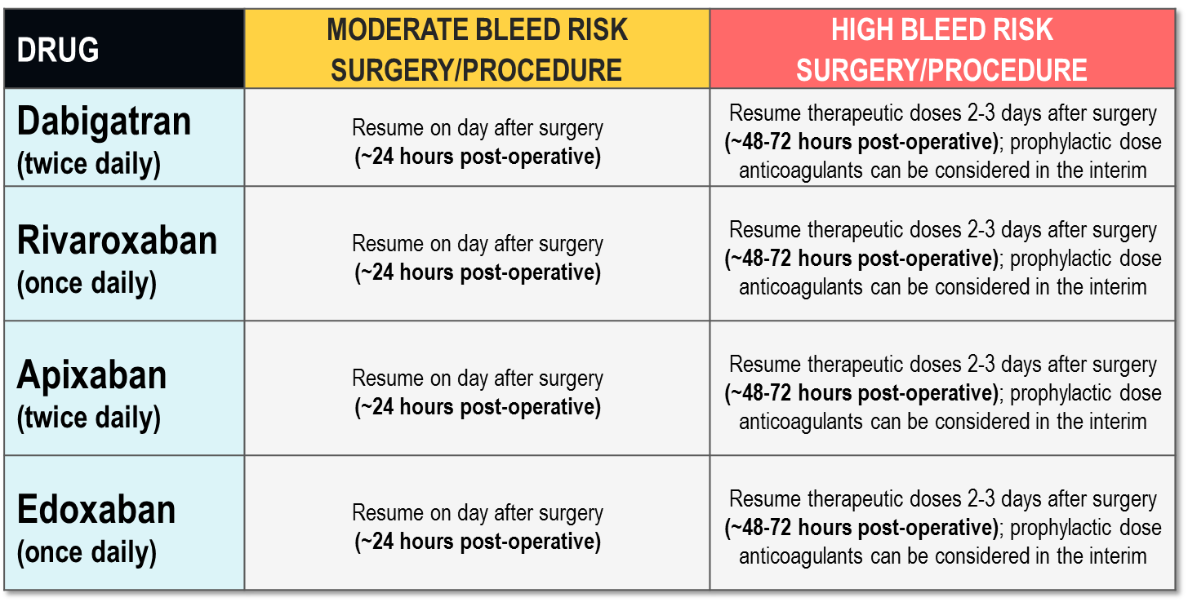

Post-Operative Guide
2017 Thrombosis Canada
Notes:
Speaker Notes:

Slide 44

Key Messages
Patients on anticoagulants will frequently require invasive procedures and surgical interventions
The decision on what to do need not be complicated and depends on :
The type of procedure planned and it’s related bleeding risk
Consideration of the specific anticoagulant used by the patient
Knowledge of the patient’s renal function
Patients with AF are often elderly with co-morbidities (e.g. renal dysfunction) which may evolve and deteriorate over time.
DOACs are all effective at stroke prevention and safe compared to warfarin. They have subtle differences which may allow clinicians to personalize their selection to the specific clinical setting.
Notes:
Speaker Notes:

